Slide 1
CLOUD BASED DISASTER MANAGEMENT SYSTEM

Slide 2
OVERVIEW
INTRODUCTION
OTHERS’ WORK
AIM AND OBJECTIVES
OUR APPROACH
FEATURE COMPARISON BETWEEN EXISTING SYSTEMS AND PROPOSED SYSTEM
DESIGN BASED ON MODULES
FURTHER WORK

Slide 3
INTRODUCTION
Disasters are unavoidable
Post disaster situations lack proper communication and coordination which leads to inefficient mitigation tasks.
Therefore handling these post disaster activities effectively and efficiently is vital.

Slide 4
OTHERS’ WORK
Sahana Eden Foundation
InSTEDD
Ushahidi
Ubuntu-ngo

Slide 5
AIM AND OBJECTIVES

Slide 6
AIM
Create a cloud based real time disaster management system that will coordinate the activities of any individuals, communities or organizations efficiently and effectively.

Slide 7
OBJECTIVES
Studying the existing disaster management systems and critically analyzing them
Researching on the cloud computing concepts
Researching on ad-hoc communication methods
Researching on data processing and analyzing the data
Researching on automated decision making techniques and implementing rule based automatic decision making system
Gathering requirements based on researches, best practices, existing systems and feedbacks from people involving in disaster management activities
Implementing a cloud based disaster management system integrating all the gathered requirements.

Slide 8
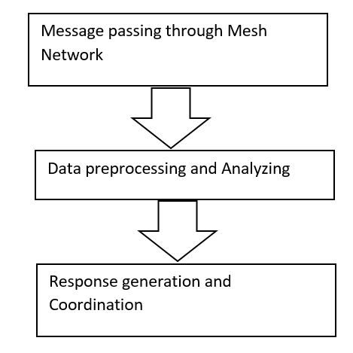
OUR APPROACH

Slide 9
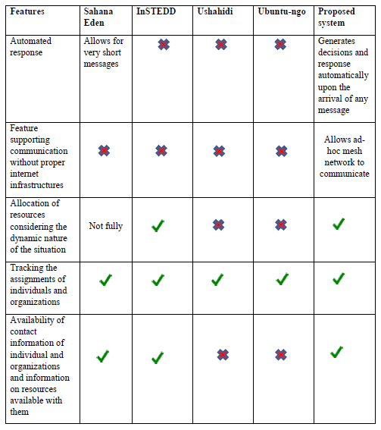
FEATURE COMPARISON BETWEEN EXISTING SYSTEMS AND PROPOSED SYSTEM

Slide 10
TECHNOLOGIES ADAPTED
Wi-Fi Direct
Android
Apache spark
Java
Java drools
MongoDB
JSP/HTML5/CSS3
Notes:
Drools – rule based decision making

Slide 11
MESSAGE PASSING THROUGH AD- HOC NETWORK

Slide 12
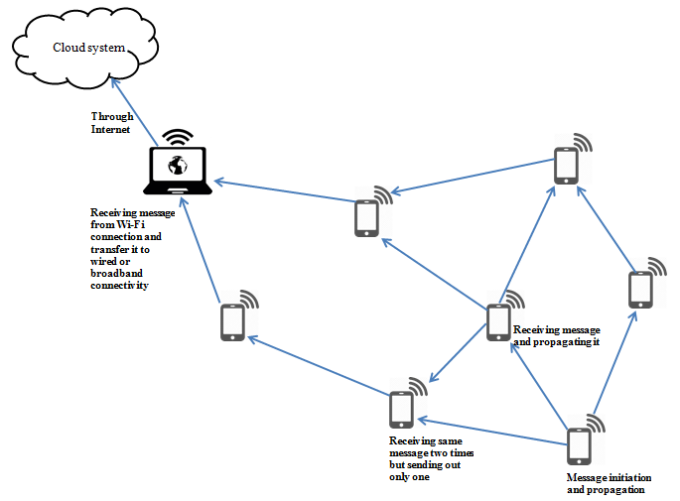
OVERVIEW OF NETWORK

Slide 13
MESSAGE FORMAT
ID | PRI | GT | PD | EM | IGD | GGD
Message ID
8bits
Message priority
4bits
Generated time
32bits
Personal data
8kbit
Emergency message
32kbits
Initiation geographic data
128bits
Gateway geographic data
128bits

Slide 14
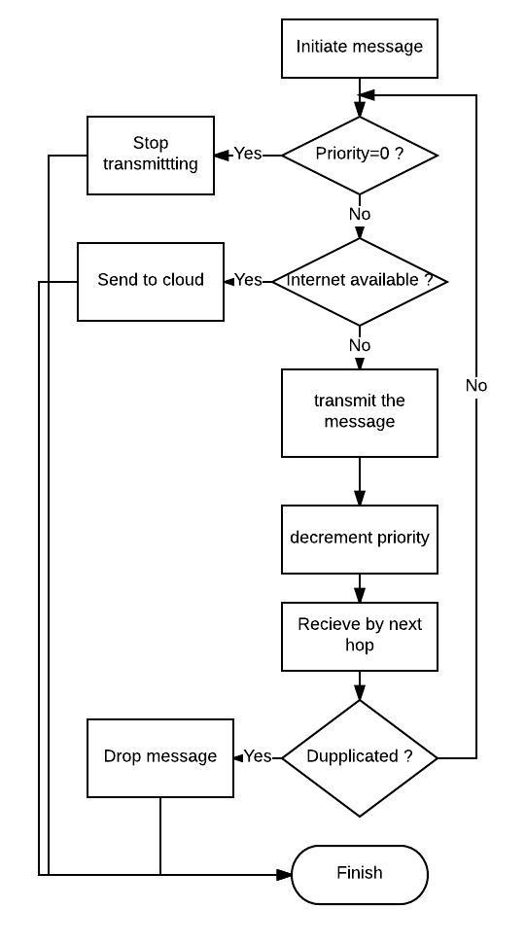

Slide 15
TEXT PREPROCESSING AND ANALYSING

Slide 16
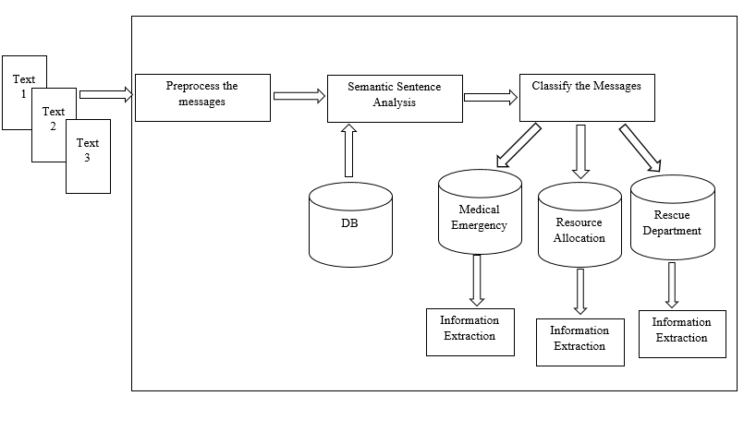
Overall Picture

Slide 17
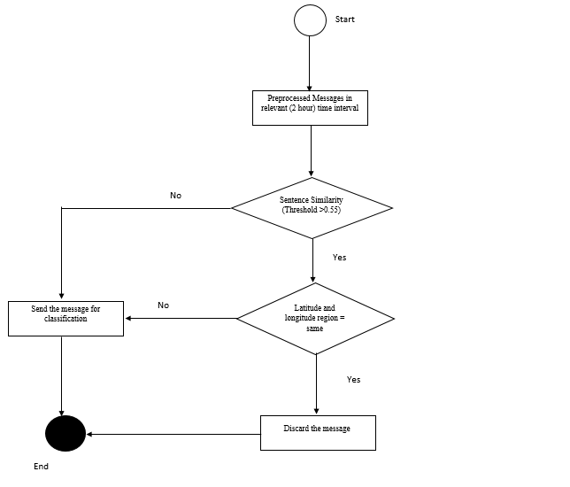
Text Preprocessing and Sentence Similarity Analysis

Slide 18
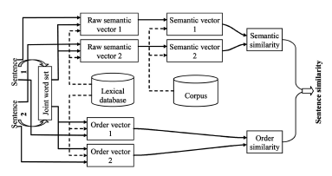
Sentence Similarity Analysis
Referred: "Sentence Similarity Based on Semantic Nets and Corpus Statistics“ by Yuhua Li, David McLean, Zuhair A. Bandar, James D. O’Shea, and Keeley Crockett
IEEE Transactions On Knowledge And Data Engineering, vol. 18, no. 8, August 2006

Slide 19
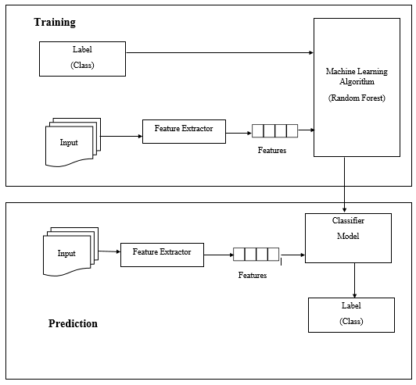
Classification

Slide 20
Information Retrieval
Relevant Word Extraction

Slide 21
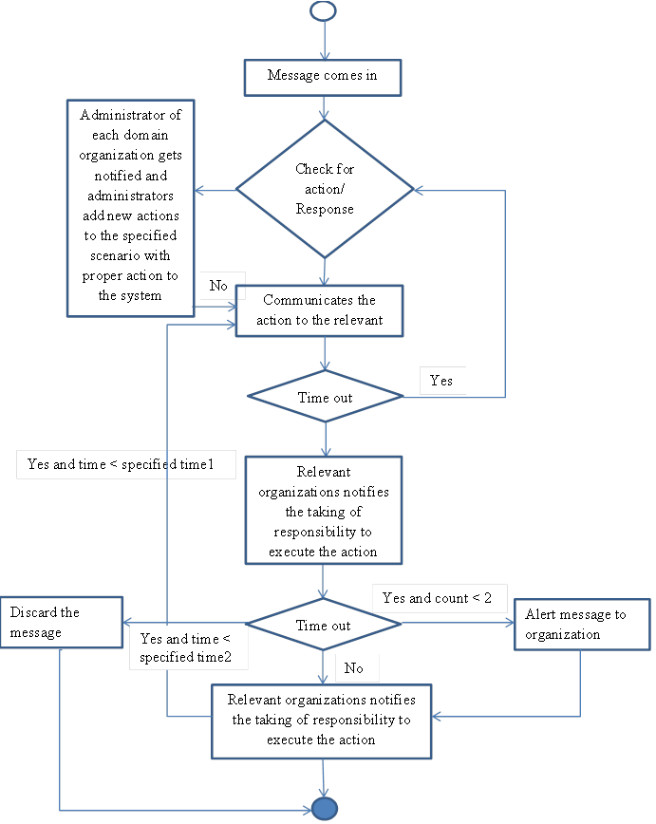
FLOW CHART OF AUTOMATED MESSAGE RESPONSE

Slide 22
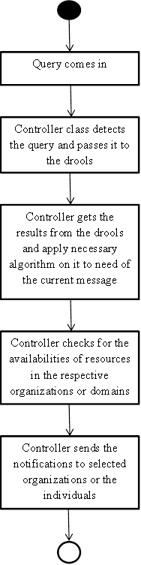
FLOW CHART FOR GENERATING RESPONSE

Slide 23
FURTHER WORK
Implementation and further research whenever required.

Slide 24
DEMO

Slide 25
THANK YOU

